Slide 1
Deep Deterministic Policy Gradient

Slide 2
Overview
Learns a Q-function and a policy concurrently
Uses off-policy data and the Bellman equation to learn the Q-function and the Q-function to learn the policy
Can only be used for environments with continuous action spaces

Slide 3

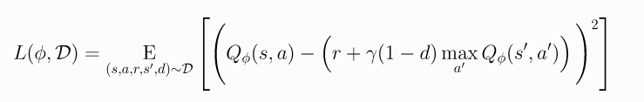

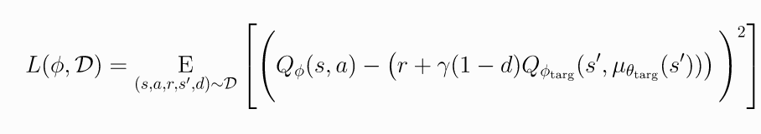
Q-Learning
Goal is to minimize mean-squared Bellman error loss function
Uses two tricks to accomplish this:
a replay buffer that contains a large range of experiences
a target network that lags behind the first, main network

Slide 4


Policy Learning
We want to learn a deterministic policy which gives the action that maximizes
Action space is continuous, so we can assume the Q-function is differentiable with respect to action, and just perform gradient ascent

Slide 5
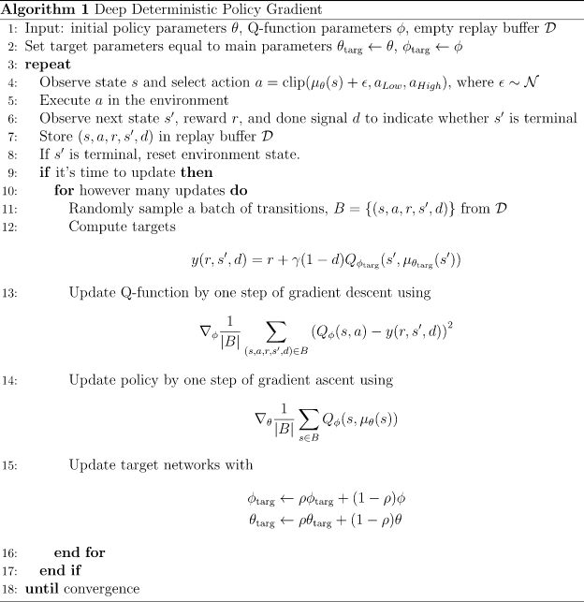
To get better explorations especially at the beginning, we use noisy perturbations. Most implementations use Ornstein-Uhlenbeck process for generating noise as suggested by the original authors, but OpenAI suggests that uncorrelated, mean-zero Gaussian noise works perfectly well, which is much simpler.

